Slide 1


TECH FRENZY
2023
PROJECT STATEMENT: MISCELLANEOUS
PROJECT NAME: SMART SPARSH
TEAM NAME: ACCESS DENIED
TEAM LEADER: PRATTUSHA PAUL
COLLEGE NAME: SILIGURI INSTITUTE OF TECHNOLOGY

Slide 2



IDEA BREIF:
To design user friendly device that empowers individuals
with disabilities to effortlessly convey their needs , emotions and messages at their convenience through simple fingertip interaction.
This device allows user to call for help and express their desires through the use of simple hand gestures via an LCD screen .The thought process behind making this device is to ease the life of physically challenged people so that they can live a better life to some extent . We have also taken into consideration the underprivileged who take benefits of the device due to low cost

Slide 3





IDEA USES:
Medical Application Gaming
Smart Sparsh would be a Arduino boards can be used to create custom
Game changer device for game controllers.
specially challenged We can build our own joystick .
people.
Smart Home Automation Data Analysis and AI Integration
This device can be used as a remote This device could incorporate machine
In daily life that can assigned to television learning algorithm to analyze tactical dat for switching on/off the lights , fans and other making it capable off recognizing and responding
devices that user want. To various touch interaction intelligently.

Slide 4

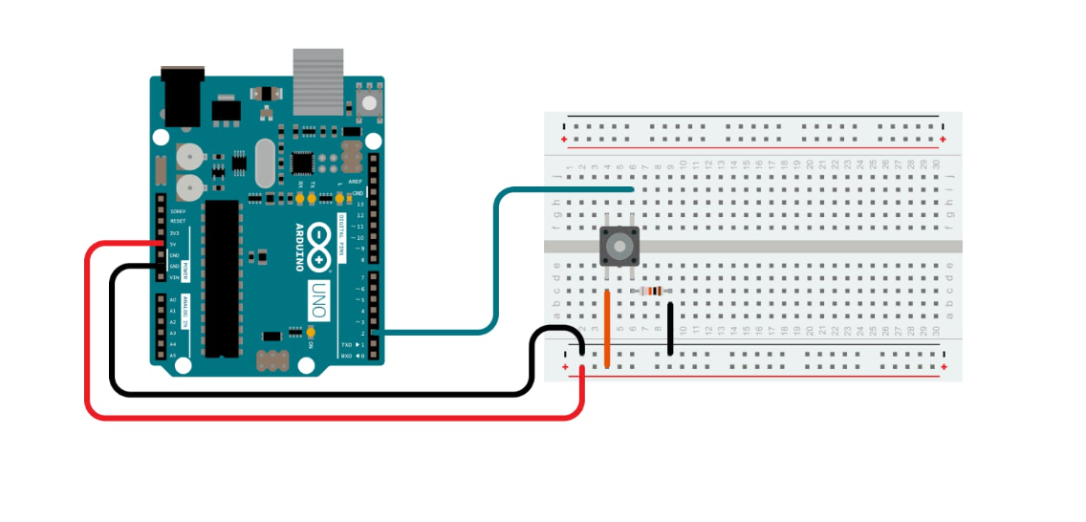
CIRCUIT DIAGRAM:
Uploading Port
D.C. Port
Reset Button
Digital Pins
Switch
(-)GND
(+)5V
Analog Pins
Resistance
Bread Board

Slide 5






Technology Stack:
Arduino Uno Hardware
It’s based on the ATmega328P microcontroller and provides I/O
Pins and various onboard components.
ARDUINO IDE
IDE software is used to write , compile and upload the code to Arduino Uno board
Peripheral and Component
To interact with physical world user will use various sensors , displays and other components
Libraries
Arduino Uno takes benefits from the vast collection of libraries simply interacting with various components
C and C++
Arduino uses a simplified version of c and c++ for programming

Slide 6

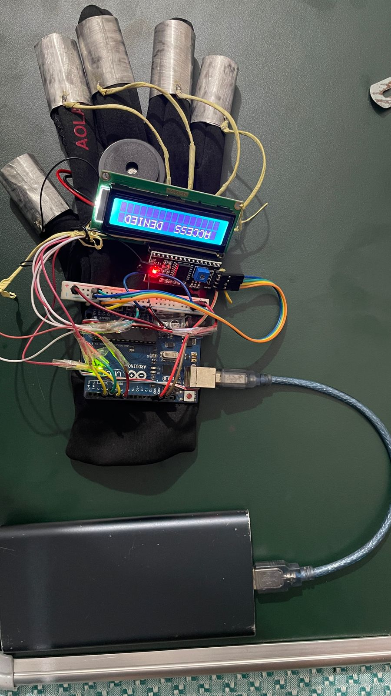

Unique Selling Point(USP):
Our revolutionary Smart Sparsh is more than just a product; it's a lifeline for people with disabilities. With cutting-edge technology and a commitment to inclusivity, we've crafted Smart Sparsh to deliver:-
Unmatched Adaptability: Our device is designed to adapt to various disabilities, allowing for customization to meet the unique needs of every user.
Seamless Integration: Our device seamlessly integrates into daily life, making it an indispensable tool for enhancing mobility, communication, and access to information.
Low Cost Production: Since our device doesn't consist of any expensive sensors
and other expensive components that makes our device most feasible one for the people belonging to any status

Slide 7

CONCLUSION:
Work flowchart:
Our program
The development of a Smart Sparsh using Arduino technology offers an innovative and inclusive solution that addresses the needs of both physically challenged individuals and those with limited financial resources. By focusing on cost-effective sensor solutions, this project ensures affordability and accessibility for a broader demographic, making it a significant step toward promoting equal opportunities for technology-driven assistance.
Ultimately, the success of this project lies in its ability to provide affordable and practical solutions, allowing individuals from all walks of life to benefit from the advantages of technology, thus embodying the true spirit of innovation and accessibility.
Furthermore, this project demonstrates the versatility of Arduino technology in creating solutions that positively impact people's lives. Whether it's controlling smart home devices, assisting in daily tasks, or enhancing communication, the one-hand remote opens up new possibilities for users, making it a valuable addition to the world of assistive technology.
void setup()
void loop()
Display on LCD
true
If (case1)
false
else(case2)

Slide 8
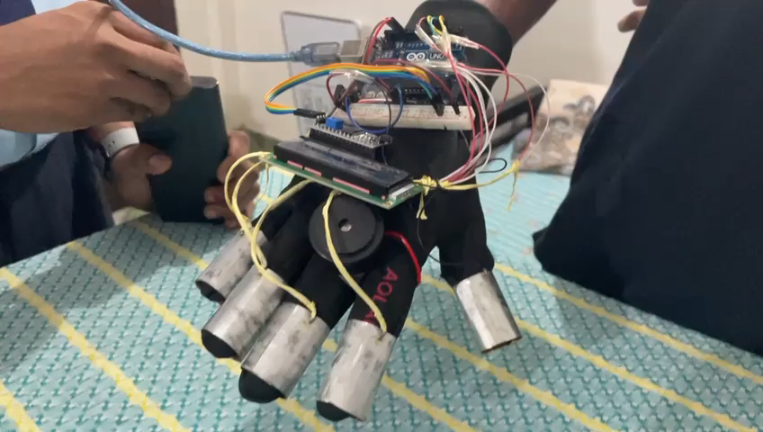
Demonstration of the video :-

Slide 9

Team Member Details:-
Team Leader Name: Prattusha Paul
Branch: B.Tech Stream:CSE(AIML) Year: I
Team Member 1 Name: Swarnim Sinha
Branch: B.Tech Stream:CSE(AIML) Year: I
Team Member 2 Name: Rachit Lochan Adhikari
Branch: B.Tech Stream:CSE(AIML) Year: I
Team Member 3 Name: Rounak Gupta
Branch: B.Tech Stream:CSE(AIML) Year: I
Team Member 4 Name: Avishek Kumar Singh
Branch: B.Tech Stream:CSE(AIML) Year: I
Team Member 5 Name: Debjyoti Das
Branch: B.Tech Stream: CSE Year: I

